Slide 1

Signaling project description (NETW704)
Tutorial 1
Abdelrahman Darwish
Email: abdel-rahman.darwish@guc.edu.eg
Office: C4.228
Slides by: Nahla Afifi

Slide 2
Project idea(🛒 Application Workflow)
1-User Registration & Login
  A new user can sign up either as a Buyer or a Seller.
  At login, the app verifies the user’s role and redirects them to the correct home screen.
2- Buyer Role
  Buyers can:
    Open the application and browse available shops (sellers).
    Select a shop to view its grocery items (products).
    Add items to their cart and place an order ,The order is then sent to the corresponding seller.
    Access a profile page to edit their personal information (e.g., name, email, address, phone).
3- Seller Role
  Sellers can:
    Add new grocery items to their shop.
    Edit or remove existing items.
    Receive incoming orders from buyers.
    Accept or reject orders based on availability or preference.
    Access a profile page to edit their shop details and personal information.

Slide 3
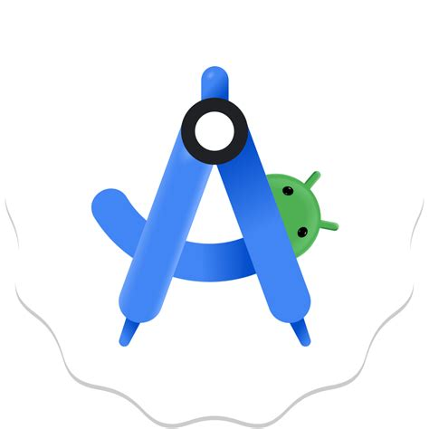


Objectives
Developing an Android Application using Kotlin and XML
Become familiar with Firebase and AWS platforms for backend development and storage.
Use Firebase Authentication for secure user login/registration and Firebase Realtime Database for storing users, products, and orders.
Work with Amazon S3 to handle product images and other media storage requirements.

Slide 4

Introduction to Android Development

Slide 5
Android Studio
it is the official integrated development environment (IDE) for Google's Android operating system, built on JetBrains' IntelliJ IDEA software and designed specifically for Android development. It is available for download on Windows, macOS and Linux based operating systems or as a subscription-based service in 2020. It is a replacement for the Eclipse Android Development Tools as the primary IDE for native Android application development.
Supported Languages:
  Kotlin (officially recommended by Google)
  Java
  C++
Alternative Cross-platform frameworks to develop android:
  React Native (JavaScript/TypeScript-based, developed by Meta)
  Flutter (Dart-based, developed by Google)

Slide 6
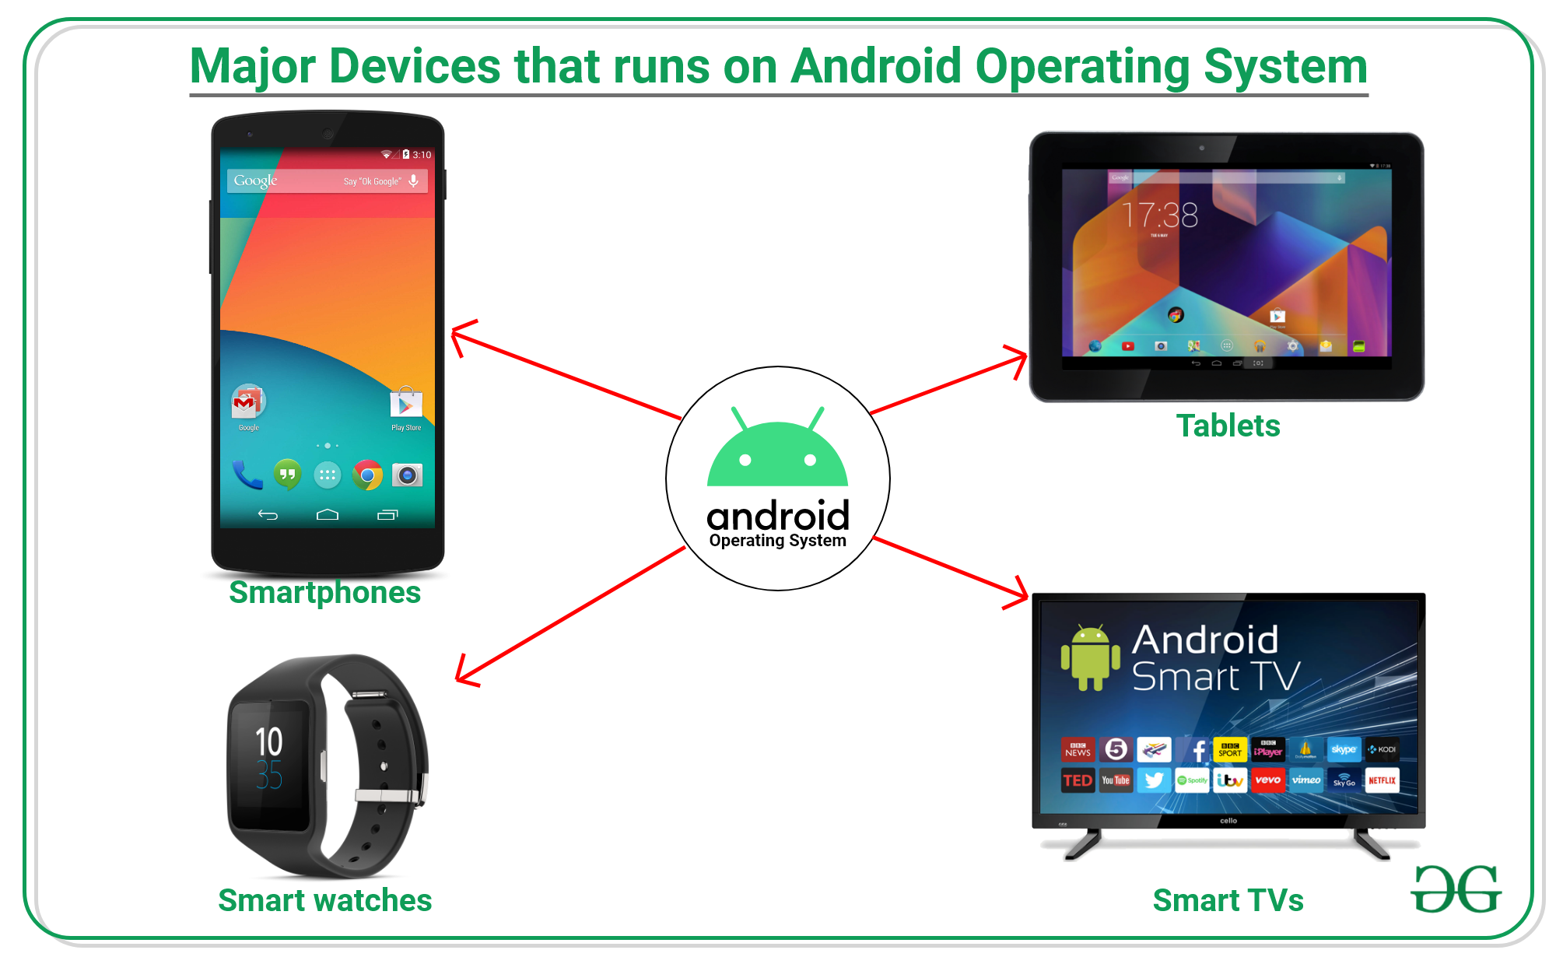

Slide 7
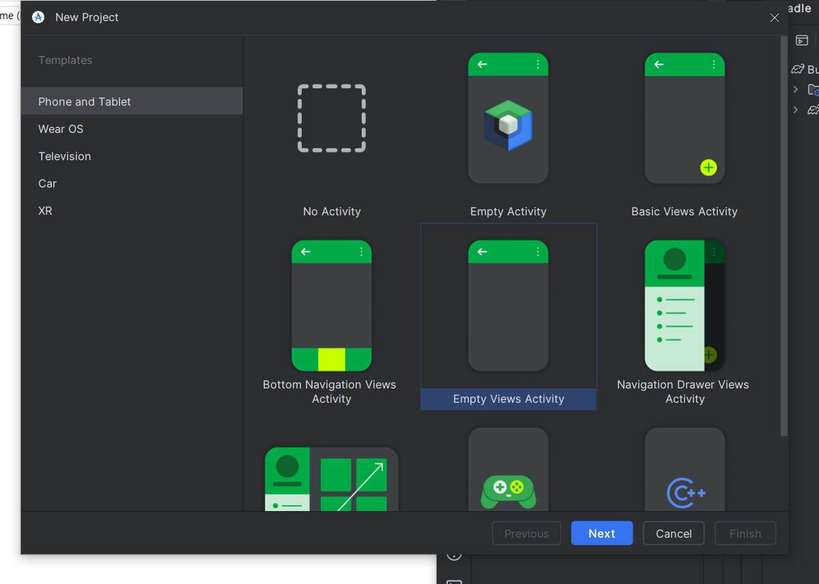
Creating your first app:

Slide 8
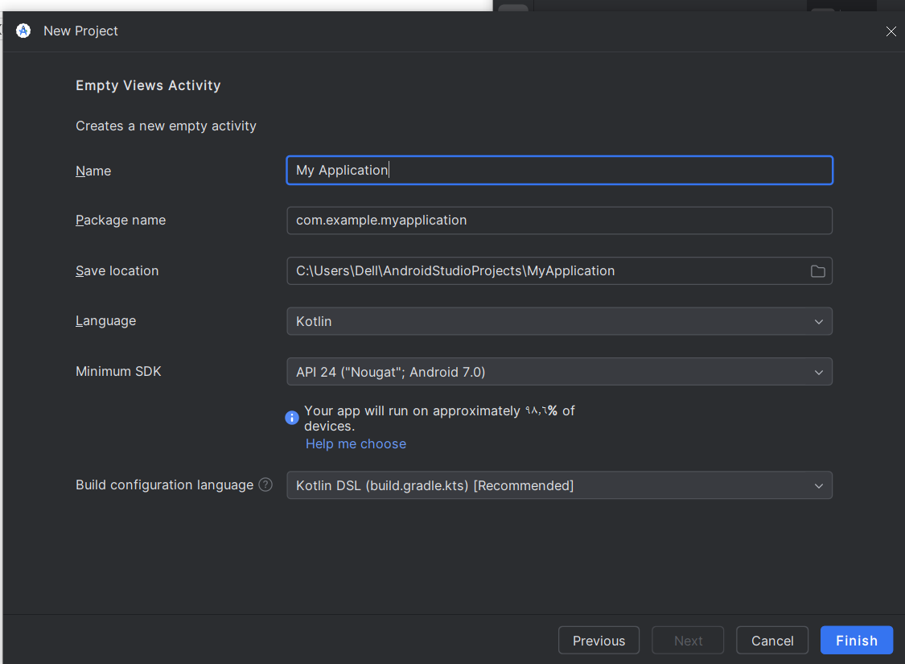
Creating your first app:

Slide 9
Creating your first app:
1- Main Activity (app > kotlin+java > com.example.myfirstapp > MainActivity.kt)
This is the starting point of your app.
When you run the app, the system launches this activity and shows its layout on the screen.
2- Layout File (app > res > layout > activity_main.xml)
Defines how the screen looks (the UI).
Example: contains a TextView that shows “Hello, World!”.
3- Manifest File (app > manifests > AndroidManifest.xml)
Like the app’s ID card.
Describes the app’s name, permissions, and its main components (activities, services, etc.).
4- Gradle Scripts (Gradle Scripts > build.gradle)
Controls how the app is built.
Two main files:
  Project build.gradle → settings for the whole project.
  Module build.gradle → settings for your app module (dependencies, SDK versions, etc.) (Most of your edits are here)..

Slide 10
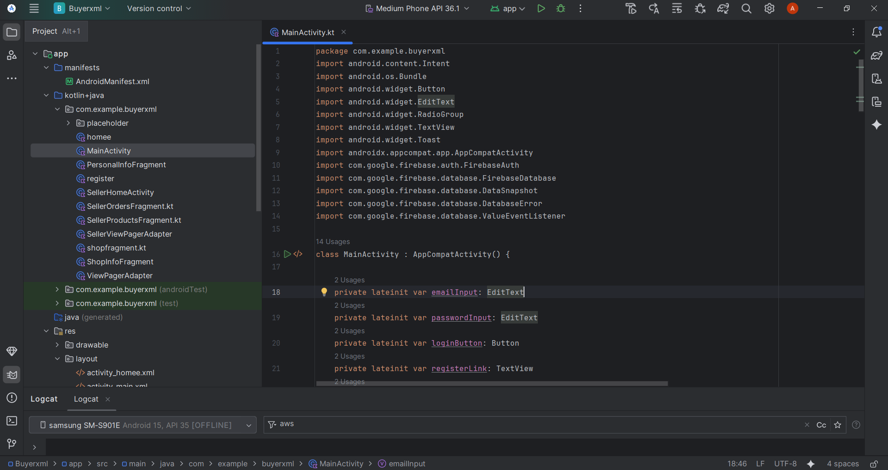

Slide 11
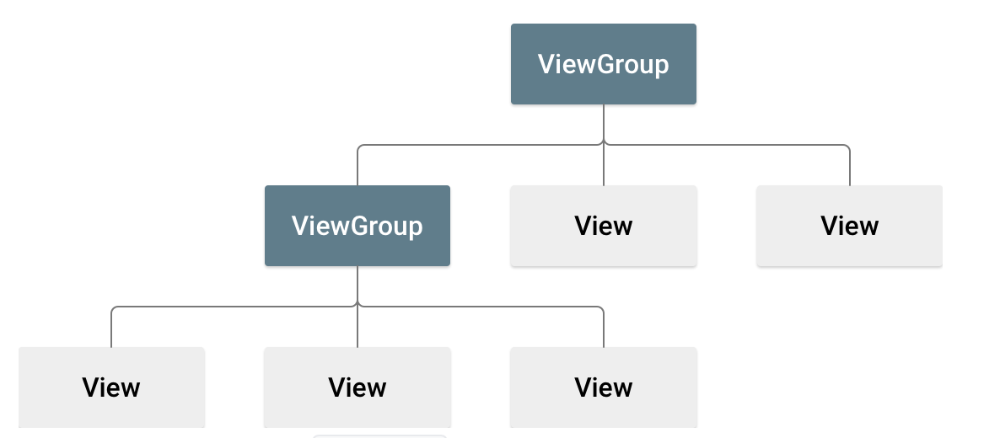
View hierarchy
Android UI Basics
The User Interface (UI) in Android is like a tree structure.
Layouts → special containers (called ViewGroup objects) that decide how child views are arranged.
Widgets → the actual UI elements (called View objects).
  Examples: TextView (for text), Button, EditText (text box).
Together, layouts + widgets = what you see on the screen.
A layout(ViewGroup objects) is like a shelf (it decides how things are placed: stacked, side by side, etc.).
Widgets(View objects) are the items on the shelf (books, photos, decorations).

Slide 12


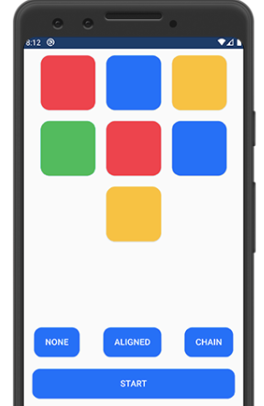
Following are certain commonly used subclasses for ViewGroup:
  LinearLayout:
    We use this layout to place the elements in a linear manner, (V or H)
  RelativeLayout:
    This layout is for specifying the position of the elements in relation to the other elements that are present there.
  Constraint layout:
    ConstraintLayout is a layout on Android that gives you adaptable and flexible ways to create views for your apps.

Slide 13
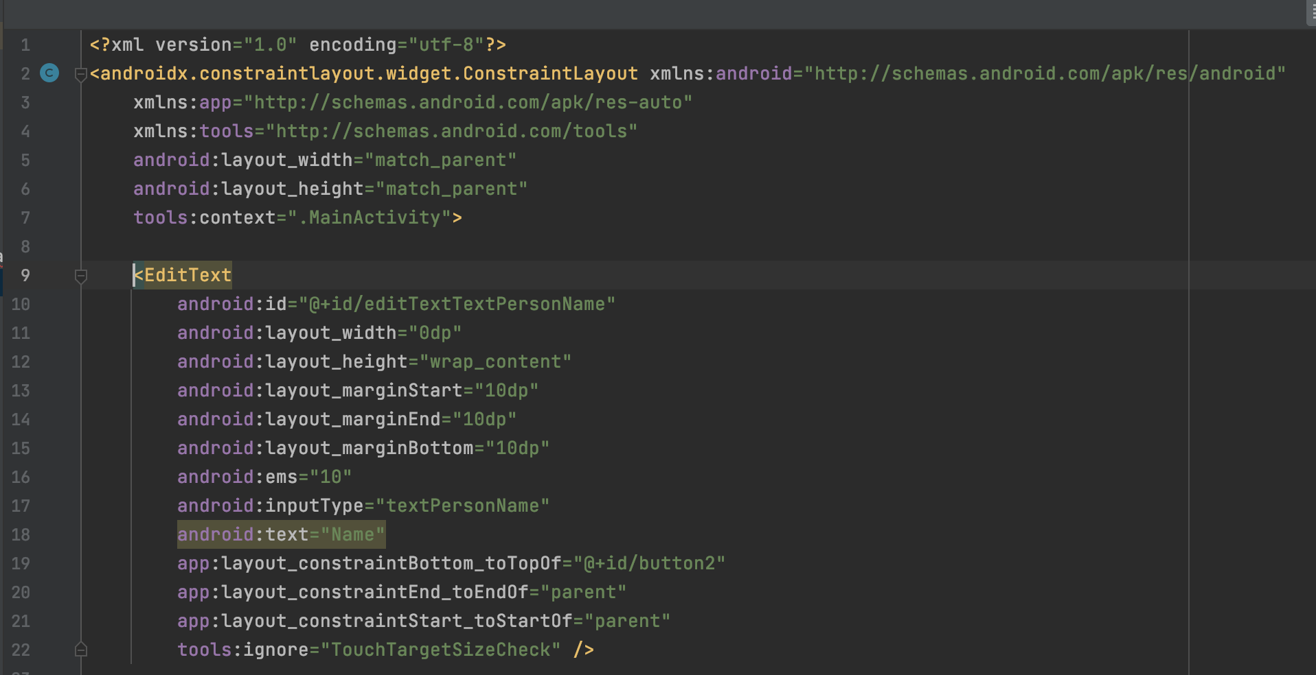
XML files
XML stands for Extensible Markup Language. XML is a markup language much like HTML used to describe data.
In Android there are several xml files used for several different purposes:
  Layout XML Files:
  Manifest xml File
  Strings xml File
  Styles xml File
  Color xml File

Slide 14
App components
App components are the essential building blocks of an Android app. Each component is an entry point through which the system or a user can enter your app. Some components depend on others.
There are four different types of app components:
  Activities
  Services
  Broadcast receivers
  Content providers
Each type serves a distinct purpose and has a distinct lifecycle that defines how the component is created and destroyed. The following sections describe the four types of app components.

Slide 15
1. Activities
An activity is the entry point for interacting with the user. It represents a single screen with a user interface.
Although the activities work together to form a cohesive user experience in the email app, each one is independent of the others.
Over the course of its lifetime, an activity goes through a number of states. You use a series of callbacks to handle transitions between states.

Slide 16
The activity states
onCreate()
  You must implement this callback, which fires when the system creates your activity. Your implementation should initialize the essential components of your activity: For example, your app should create views and bind data to lists here. Most importantly, this is where you must call setContentView() to define the layout for the activity's user interface.
  When onCreate() finishes, the next callback is always onStart().

Slide 17
2. onStart()
  As onCreate() exits, the activity enters the Started state, and the activity becomes visible to the user. This callback contains what amounts to the activity’s final preparations for coming to the foreground and becoming interactive.
3. onResume()
  The system invokes this callback just before the activity starts interacting with the user. At this point, the activity is at the top of the activity stack, and captures all user input. Most of an app’s core functionality is implemented in the onResume() method.
  The onPause() callback always follows onResume().

Slide 18
3. onPause()
Called when the activity loses focus (e.g., user presses Back, opens Recents, or another activity appears).
The activity is still partially visible but not in the foreground.
Can still update the UI if the user expects it (e.g., navigation map).
❌ Do not use for saving data, making network calls, or heavy operations.
After onPause() finishes:
onResume() is called if the user comes back.
onStop() is called if the activity is fully hidden.

Slide 19
4. onStop()
Called when the activity is no longer visible to the user.
Happens if:
  The activity is being destroyed.
  A new activity starts.
  Another activity comes to the foreground and fully covers it.
At this point, the activity is completely hidden.
Next callback:
  onRestart() → if the activity comes back to the user.
  onDestroy() → if the activity is finishing/terminated.

Slide 20
5. onRestart()
  The system invokes this callback when an activity in the Stopped state is about to restart. onRestart()restores the state of the activity from the time that it was stopped.
  This callback is always followed by onStart().
6. onDestroy()
  The system invokes this callback before an activity is destroyed.
  This callback is the final one that the activity receives. onDestroy() is usually implemented to ensure that all of an activity’s resources are released when the activity, or the process containing it, is destroyed.
  This section provides only an introduction to this topic. For a more detailed treatment of the activity lifecycle and its callbacks, see The Activity Lifecycle.

Slide 21
To sum it up
Method | Description
onCreate | called when activity is first created.
onStart | called when activity is becoming visible to the user.
onResume | called when activity will start interacting with the user.
onPause | called when activity is not visible to the user.
onStop | called when activity is no longer visible to the user.
onRestart | called after your activity is stopped, prior to start.
onDestroy | called before the activity is destroyed.

Slide 22
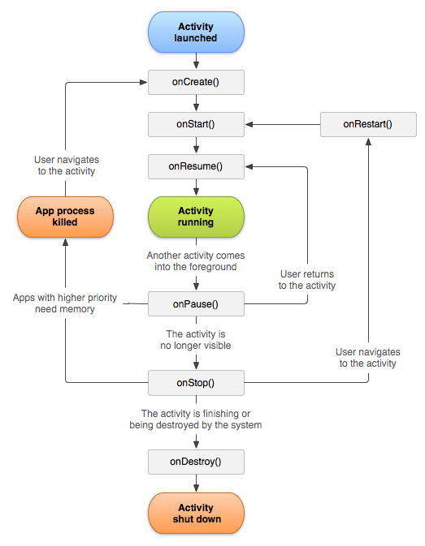
The activity life cycle
The 7 lifecycle method of Activity describes how activity will behave at different states.

Slide 23
2. Services
Service in Android:
  Runs in the background, no UI.
  Used for long-running tasks (network, sync).
  Keeps app alive even when user switches apps.
Types of Services
  Foreground → Visible, shows notification (e.g., downloads).
  Background → Hidden, runs silently (e.g., syncing, storing data).
  Bound → Runs only while another component is bound via bindService()(e.g., Real-time Order Status).

Slide 24
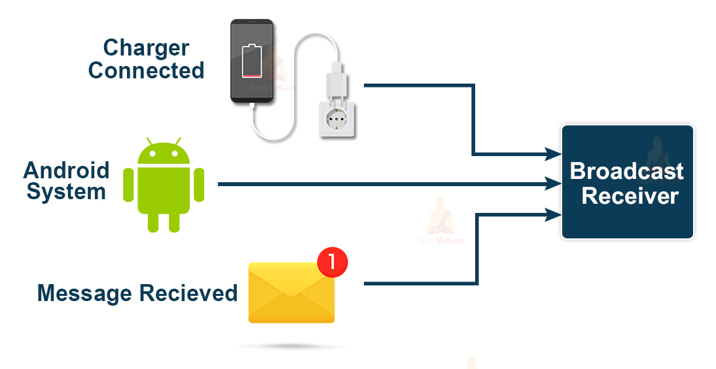
3. Broadcast receivers
Definition: A component that lets the app listen for system-wide events and respond, even if the app has no UI open.
Key Point: Works in the background; reacts when the system (or another app) sends a broadcast.
🔹 Examples of System Broadcasts
  🔋 Battery low (ACTION_BATTERY_LOW)
  📶 Network/Wi-Fi change (CONNECTIVITY_ACTION)
  📱 Device boot completed (BOOT_COMPLETED)

Slide 25
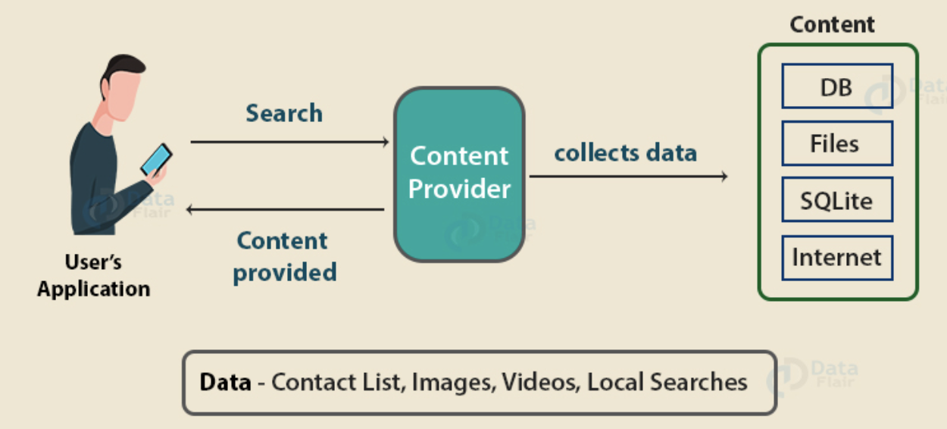
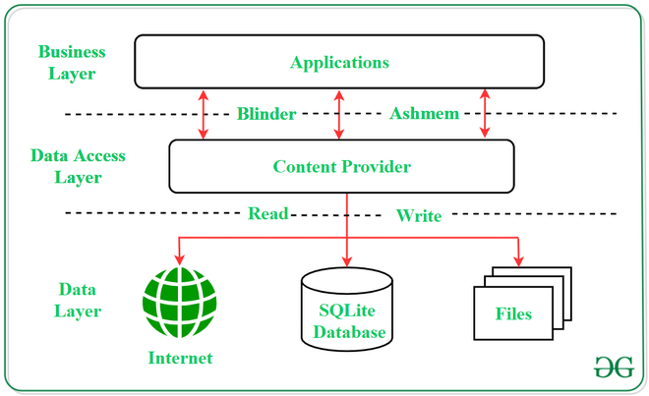
4. Content providers
They handle the access to the central repository and supply data from one application to another on request. This task of handling is done by methods of ContentResolver class. So, content providers can store data in various ways such as files, database or over the internet.
🛠 Example Use Case
Contacts App → Provides contact data to Messaging App or WhatsApp using a Content Provider.

Slide 26
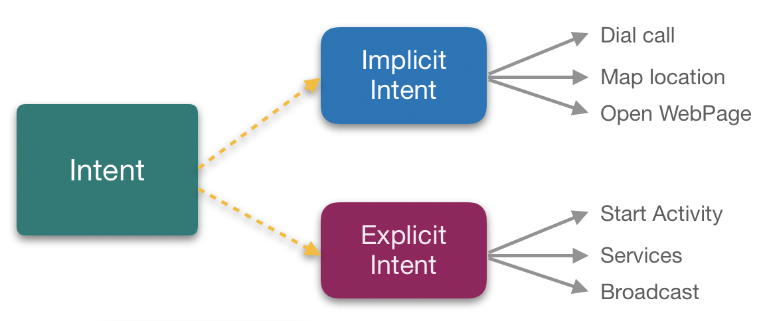
Intents
Definition: An Intent is used to perform an action (start Activity, Service, or Broadcast) or send data/messages between components.
Types of Intents :
1️⃣ Implicit Intent
  Does not specify the target component.
  System decides which app can handle the action.
  Example: Open a webpage → shows browser options.
2️⃣ Explicit Intent
  Directly specifies the target component/class.
  Used for communication within the same app.
  Example: Button click → Open another Activity.

Slide 27
The manifest file
AndroidManifest.xml
  The manifest file is at the root of the project and declares all app components.
  The Android system reads this file before launching components.
🔹 What the Manifest Does
  Declares app components (Activities, Services, etc.).
  Identifies user permissions (e.g., Internet, Contacts).
  Declares minimum API Level required(minimum Android version).
  Declares hardware/software features (Camera, Bluetooth, Multitouch).
  Declares external libraries needed (e.g., Google Maps).

Slide 28
App resources
An Android app needs more than just code; it also requires resources such as:
  Images, audio files, animations
  Menus, styles, colors
  Layouts for activities (XML files)
Using resources allows you to update the app’s appearance or behavior without changing the code.
Each resource gets a unique integer ID by the SDK build tools, which lets you reference it in code or XML.

Slide 29
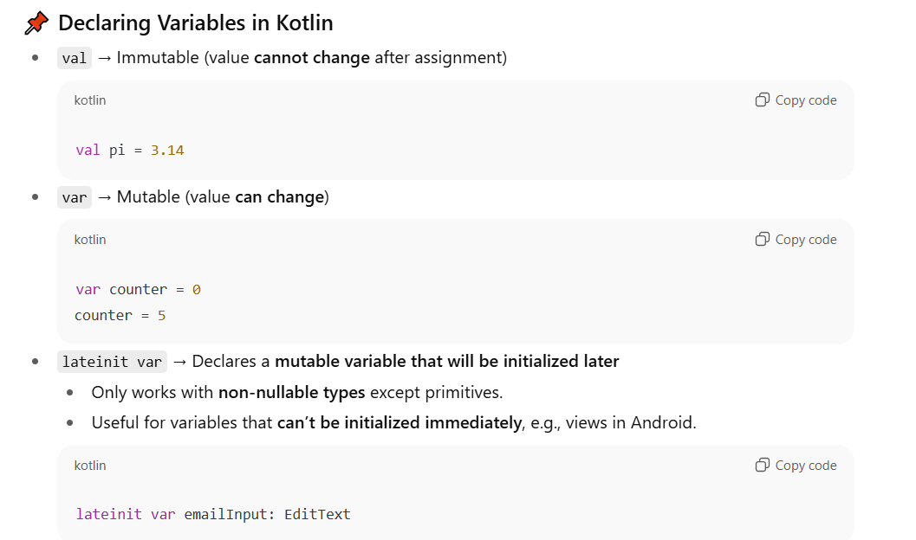
Intro To Kotlin

Slide 30
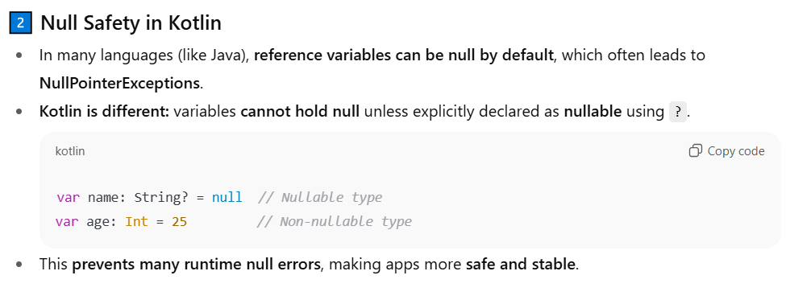
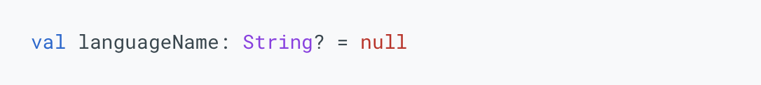
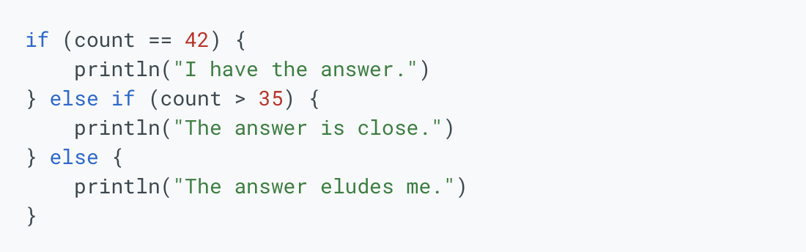
3. If Conditions:

Slide 31
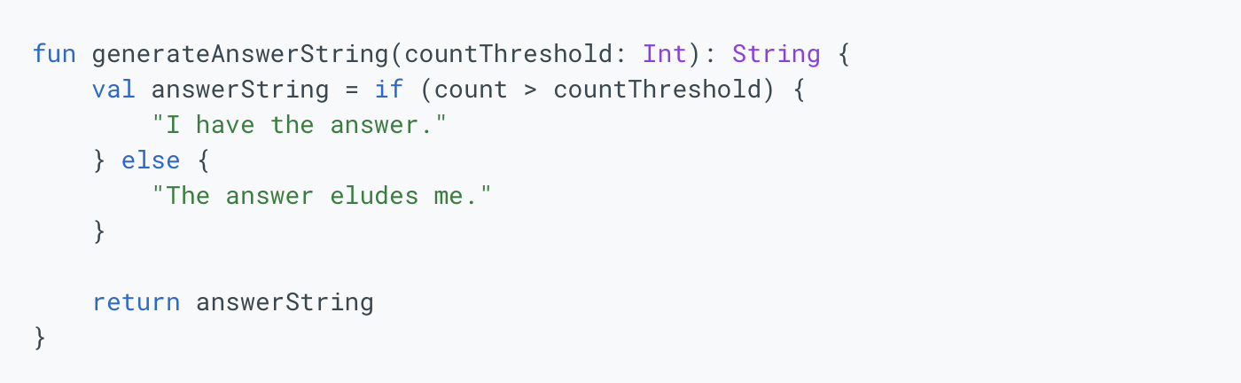
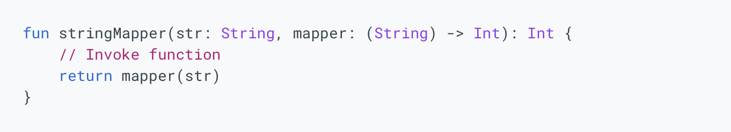
Building a function:
  A function can take another function as an argument. Functions that use other functions as arguments are called higher-order functions.
Output datatype

Slide 32
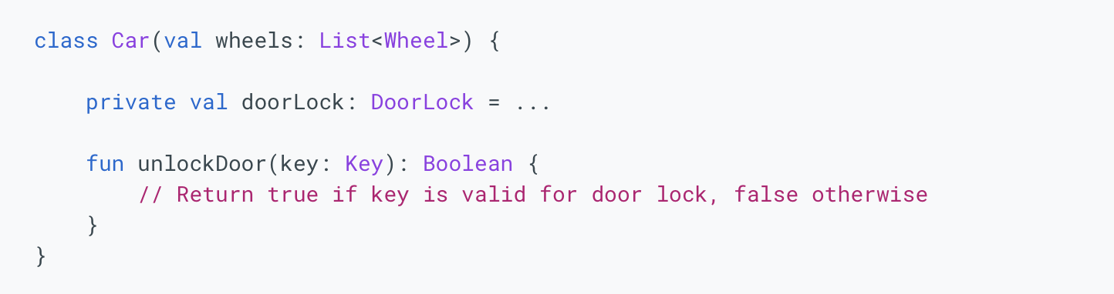
5. Constructing a Class:

Slide 33
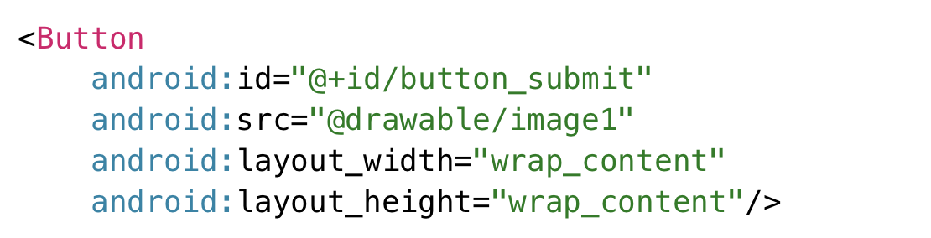
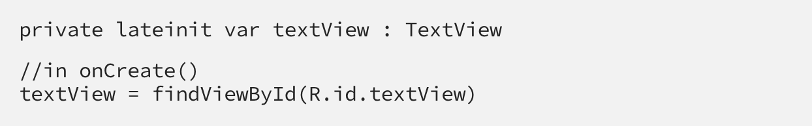
How to bind views from xml file to your code?
When you create any item, an id is automatically assigned to it.
In the kotlin file we will do the following code to link this edit text to a local variable.
Now we can use it in our kotlin file.
Tip: Always create a new Activity for a new screen instead of just creating a Kotlin file and XML file separately.

Slide 34
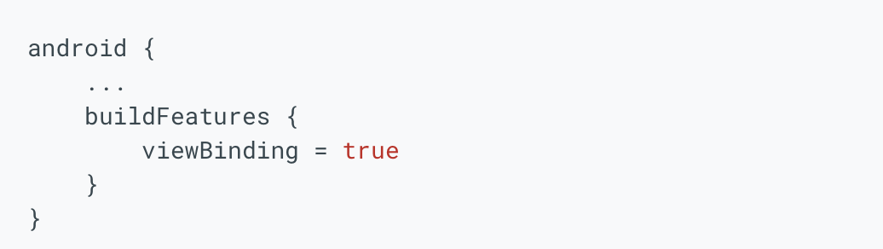
View binding
View Binding in Android
  Purpose: Makes it easier to interact with views in your code.
  Once enabled, a binding class is generated for each XML layout.
  The binding class provides direct references to all views with an ID, replacing findViewById.
Enable View Binding in Gradle
  You need to open your app-level build.gradle.kts file (the one located in the app/ directory) and add the viewBinding feature block inside the android { ... } block.

Slide 35
Cont. View Binding
When view binding is enabled for a module:
  A binding class is generated for each XML layout file in the module.
  Each binding class contains references to:
    The root view of the layout.
    All views that have an ID assigned.
  The binding class name is created by:
    Converting the XML file name to PascalCase.
    Appending the word Binding at the end.
  Every binding class provides a getRoot() method to access the root view directly.

Slide 36
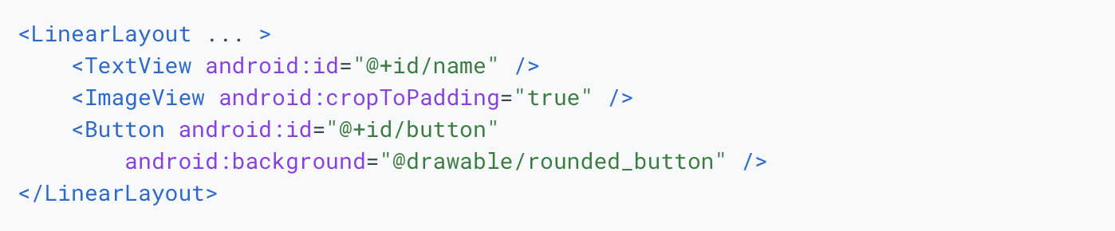
Cont. View Binding
For example, consider a layout file called result_profile.xml
The generated binding class is called ResultProfileBinding. This class has two fields: a TextView called name and a Button called button. The ImageView in the layout has no ID, so there is no reference to it in the binding class.
In this example, the getRoot() method in the ResultProfileBinding class returns the LinearLayout root view.

Slide 37
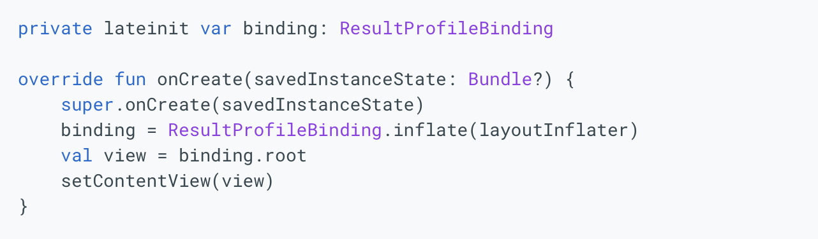
Cont. View Binding
To set up an instance of the binding class for use with an activity:
  Call the static inflate() method included in the generated binding class. This creates an instance of the binding class for the activity to use.
  Get a reference to the root view by either calling the getRoot() method or using Kotlin property syntax.
  Pass the root view to setContentView() to make it the active view on the screen.

Slide 38
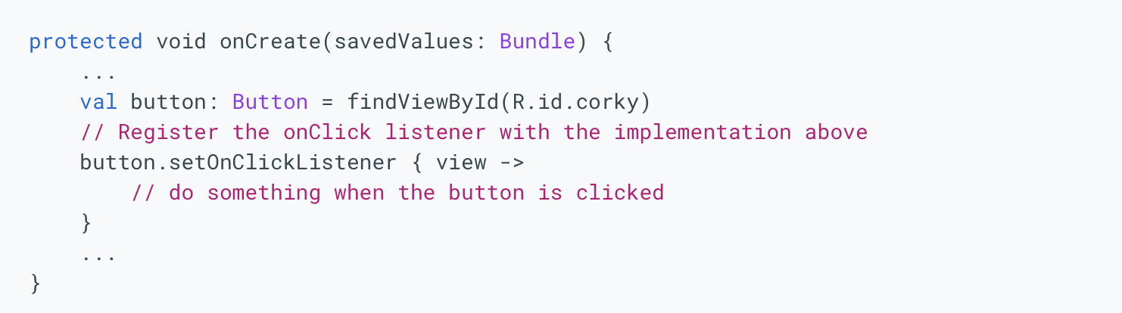

Listen And Response Button Click Event.

Slide 39
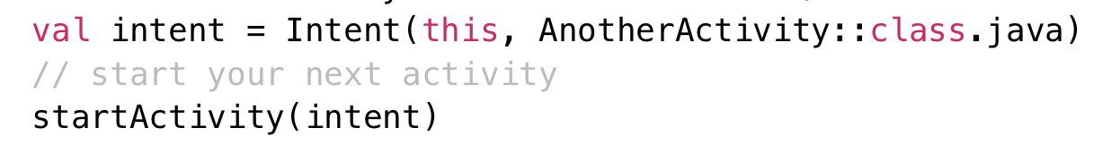
Using intents
You may send data or not when using intents to move between activities or to different apps.
  This code uses intents without any data being transfered.

Slide 40
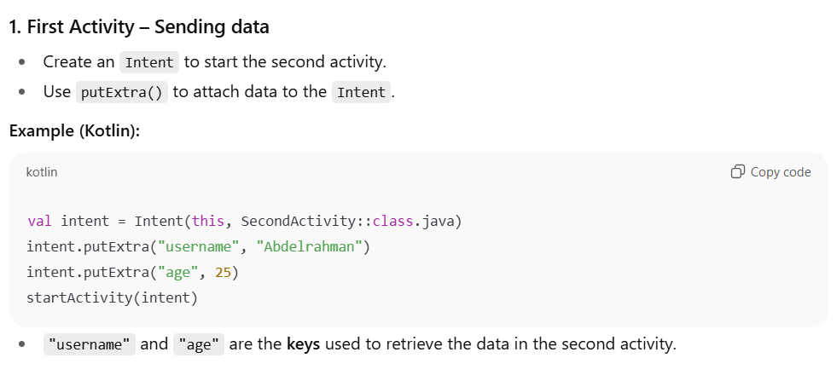

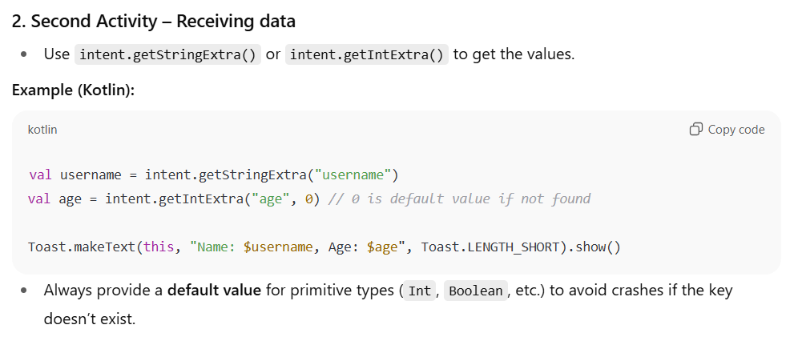

  Sending data from an intent to an intent

Slide 41
Firebase Services

Slide 42
What is Firebase?
Firebase Overview
  Platform Type: Backend-as-a-Service (BaaS), built and managed by Google.
  Core Function: Provides a unified set of tools and cloud services to help developers build, grow, and operate mobile and web applications efficiently.
  Database Model: Primarily a NoSQL database program that stores application data in flexible, hierarchical JSON-like documents.
  Key Features (Build & Grow)
    Authentication (Auth): Provides managed user identity (sign-in/sign-up) using email, Google, and other providers.
    Realtime Database & Firestore: Scalable databases supporting live data synchronization across all connected users (realtime capability).
    Cloud Storage: Secure object storage for large files, such as user photos, videos, and media.
    Cloud Messaging (FCM): Enables sending targeted push notifications and messages to users.
    Analytics: Free, unlimited reporting on user behavior to inform growth strategies.
    Hosting: Fast and secure hosting for web apps and static content.

Slide 43
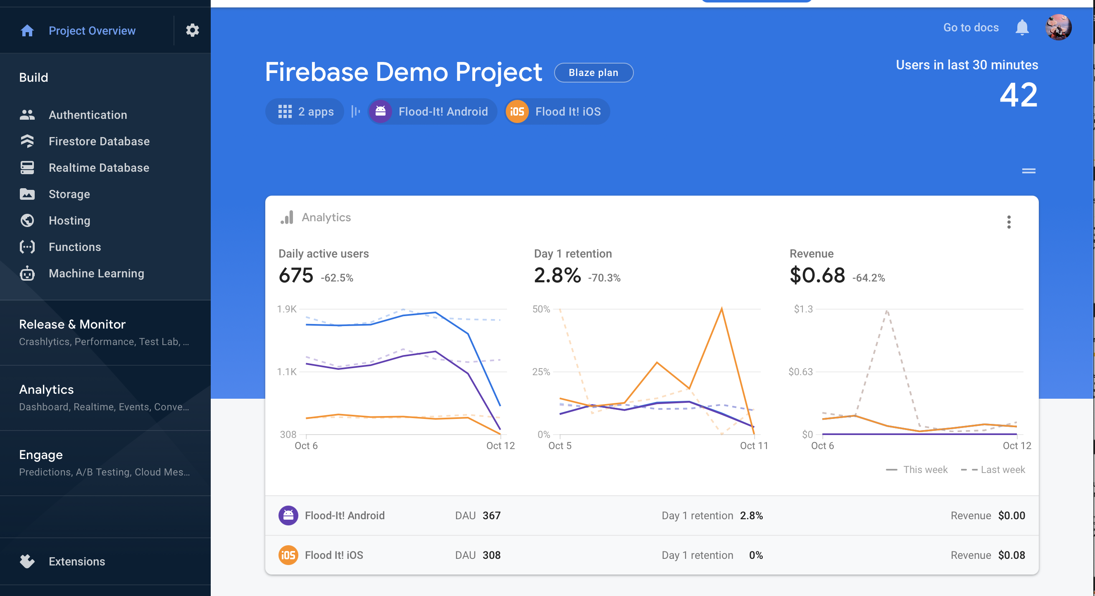
How to use Firebase with android development:
Create a Firebase project:
  you need to create a Firebase project to connect to your Android app
  Visit firebase console: https://console.firebase.google.com/
  Add new project

Slide 44
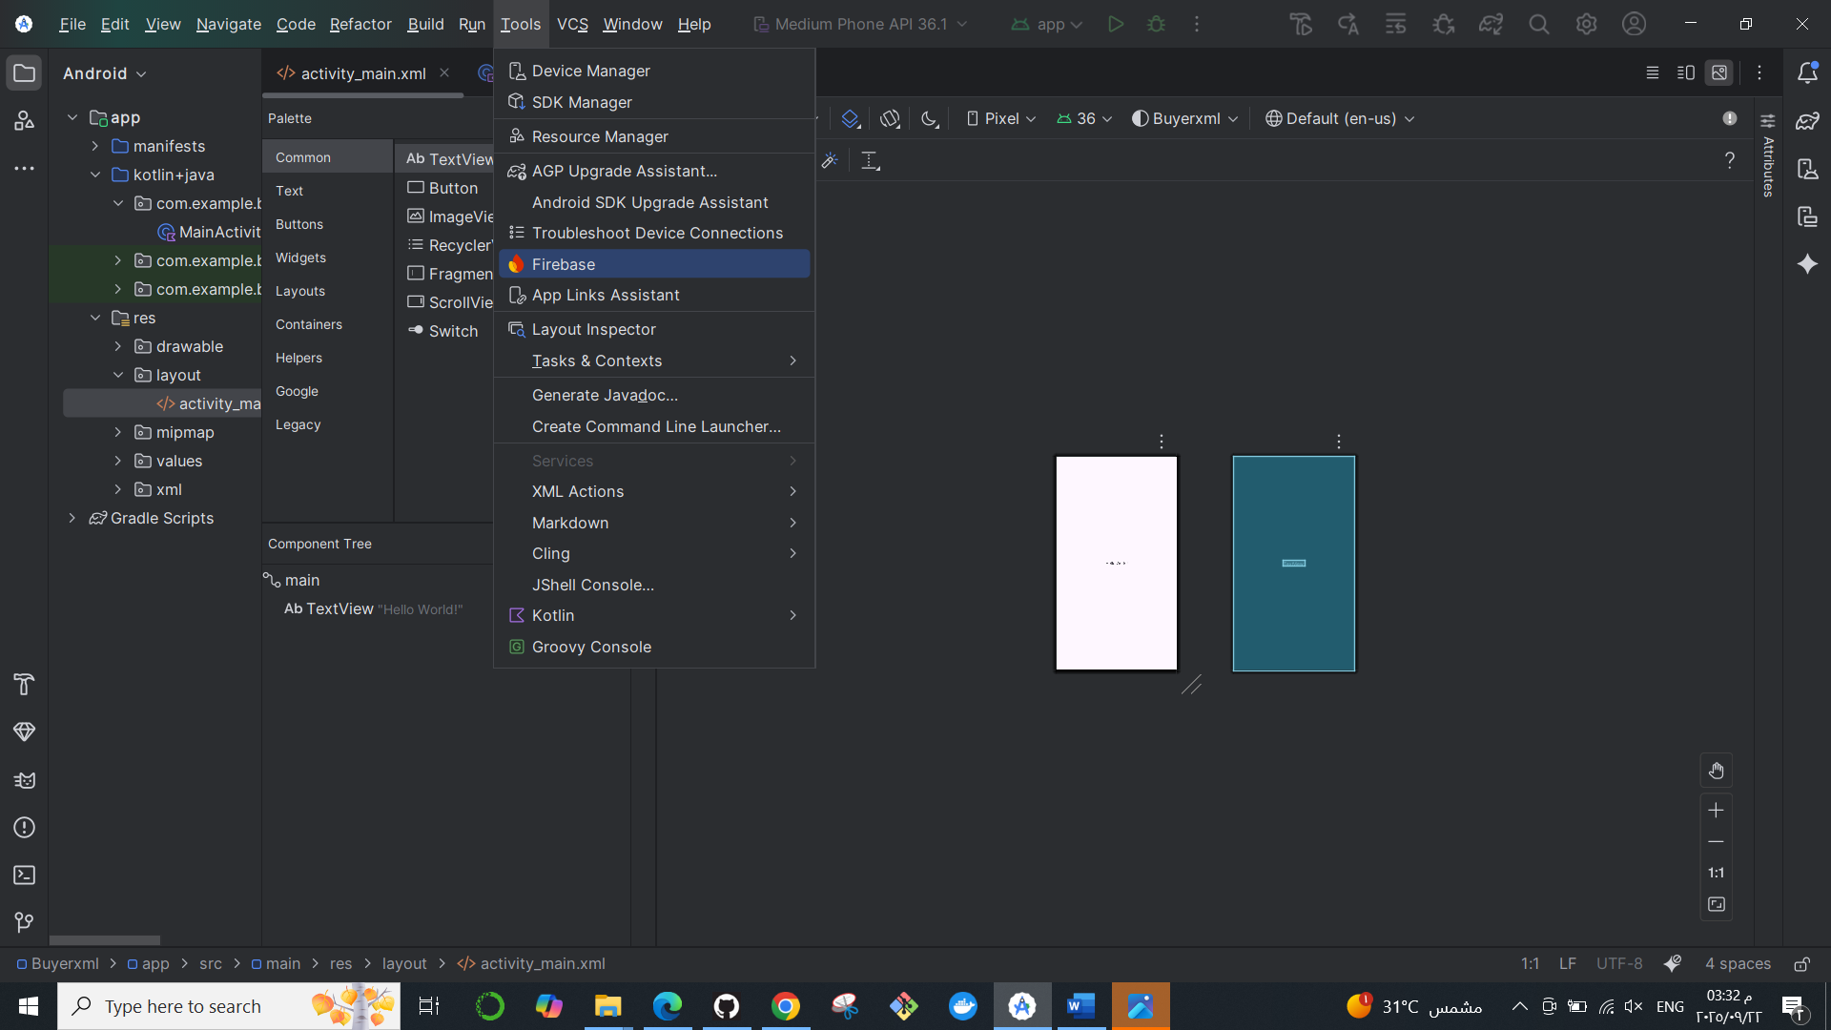
2. Register your app with Firebase auth & realtime-data base:
  https://www.geeksforgeeks.org/firebase/login-and-registration-in-android-using-firebase-in-kotlin/

Slide 45
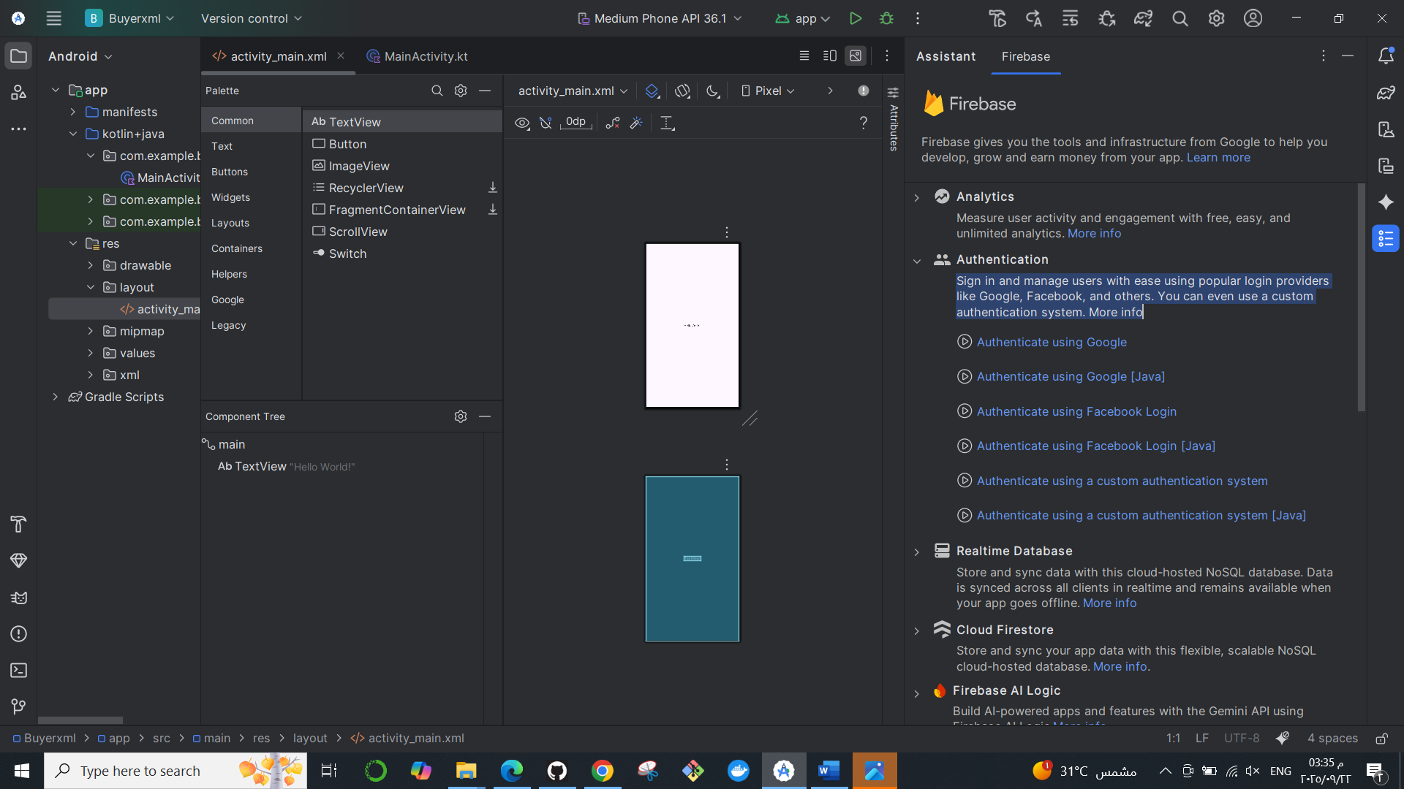
2. Register your app with Firebase auth & realtime-data base:
  https://www.geeksforgeeks.org/firebase/login-and-registration-in-android-using-firebase-in-kotlin/

Slide 46
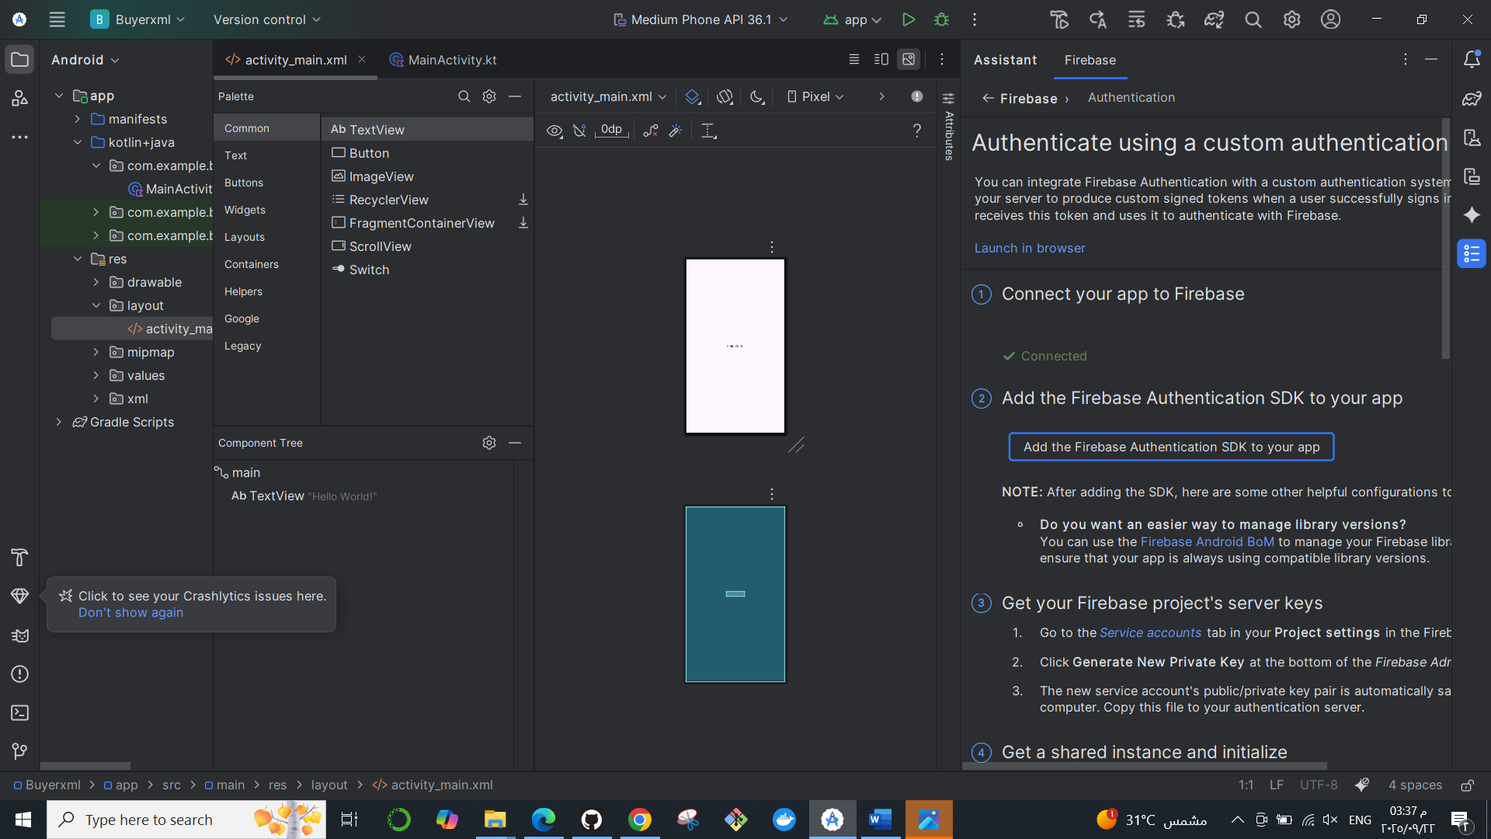
2. Register your app with Firebase auth & realtime-data base:
  https://www.geeksforgeeks.org/firebase/login-and-registration-in-android-using-firebase-in-kotlin/

Slide 47
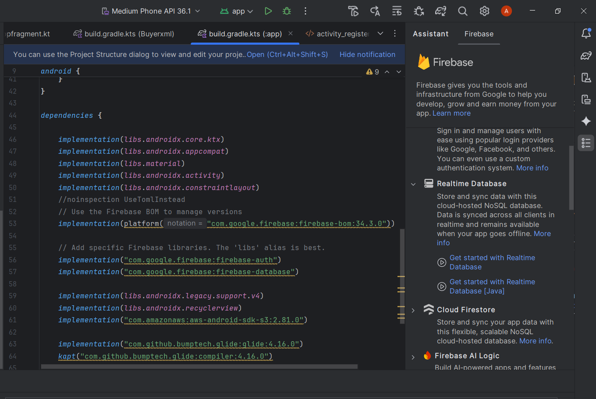
2. Register your app with Firebase auth & realtime-data base:
  https://www.geeksforgeeks.org/firebase/login-and-registration-in-android-using-firebase-in-kotlin/

Slide 48
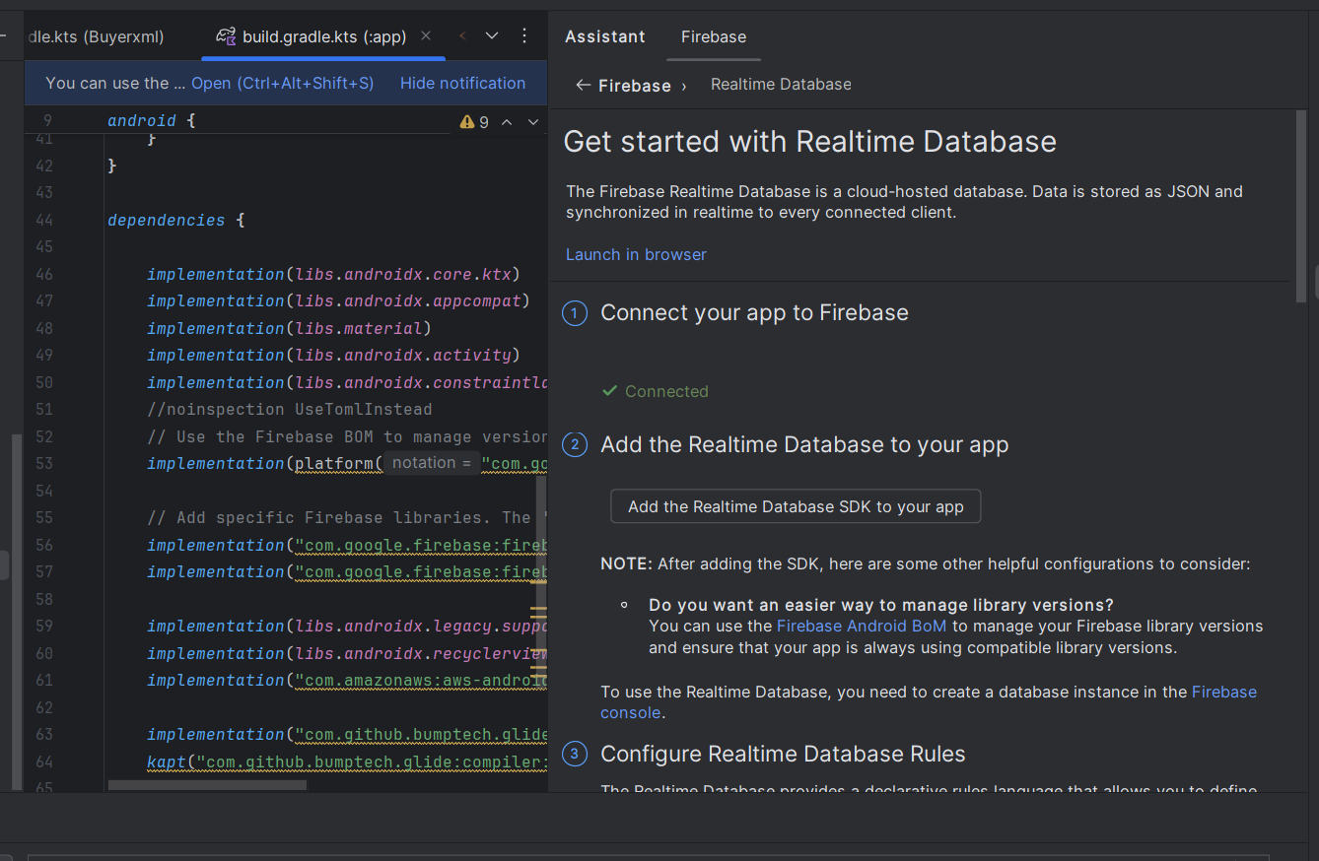
2. Register your app with Firebase auth & realtime-data base:
  https://www.geeksforgeeks.org/firebase/login-and-registration-in-android-using-firebase-in-kotlin/

Slide 49
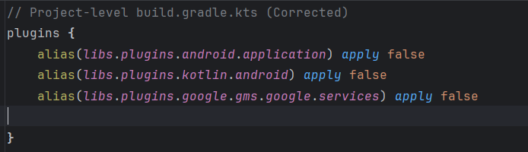
3. check configuration file:
  To enable Firebase products in your app, ensure the existence of the google-services plugin to your Gradle files (Project).

Slide 50
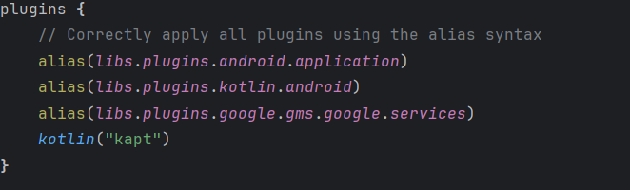
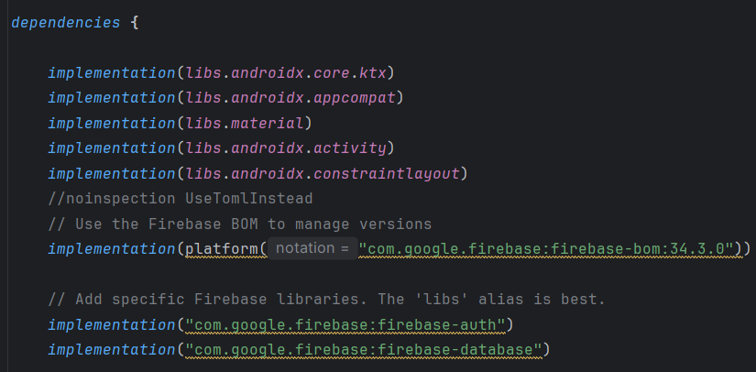
3. check configuration file:
  2-In your module (app-level) Gradle file (usually app/build.gradle), ensure the Google Services Gradle plugin:

Slide 51
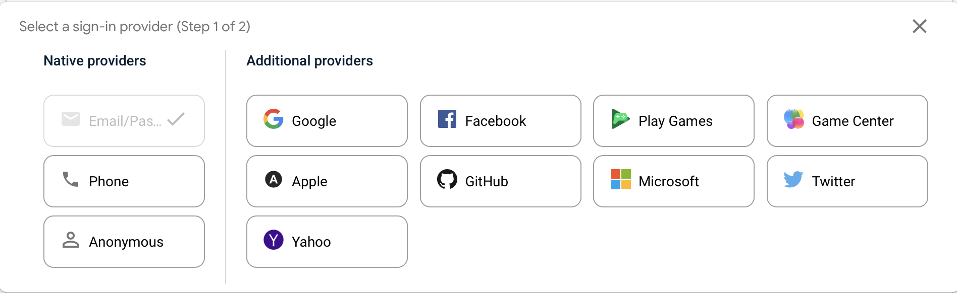
Authentication
Firebase Authentication provides backend services, easy-to-use SDKs, and ready-made UI libraries to authenticate users to your app.
Just enable the desired method to use it I your app.

Slide 52
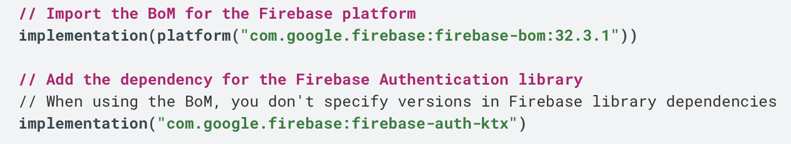
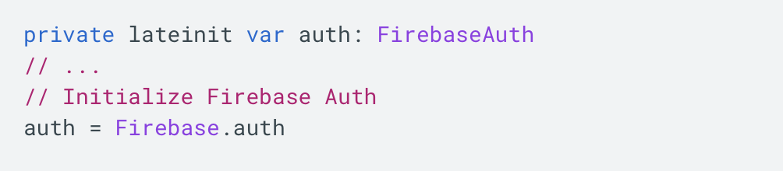
Auth code:
Add the Auth modules to dependecies:
In your sign-up activity's onCreate method, get the shared instance of the FirebaseAuth object:
Signup or signin users…

Slide 53
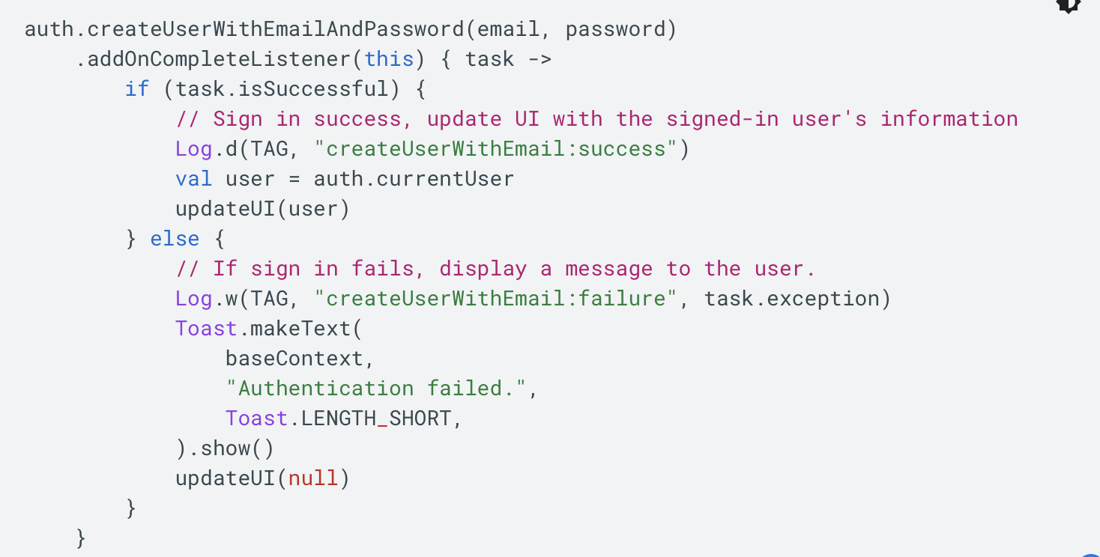
Create user with username & password:

Slide 54
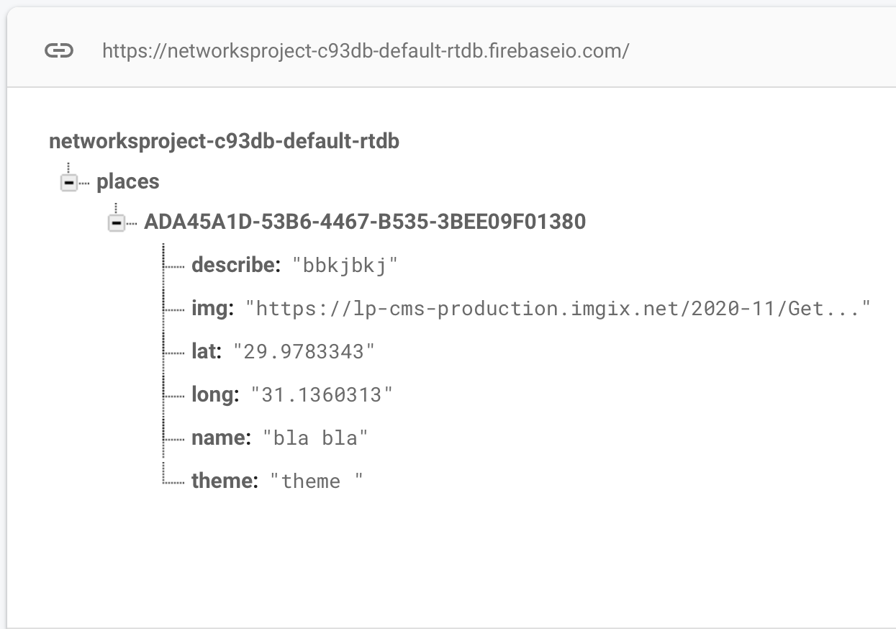
Firebase realtime database:
The Firebase Realtime Database is a cloud-hosted database. Data is stored as JSON and synchronized in real-time to every connected client. When you build cross-platform apps with our iOS, Android, and JavaScript SDKs, all of your clients share one Realtime Database instance and automatically receive updates with the newest data.
Firebase db is nosql database.

Slide 55
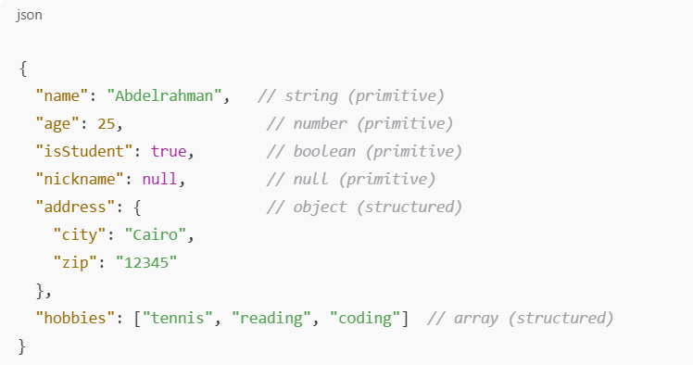
JSON
Type: Lightweight data-interchange format.
Human & Machine Friendly:
  Easy for humans to read and write.
  Easy for machines to parse and generate.
Origin: Based on a subset of the JavaScript programming language.
Data Types:
  Primitive types: string, number, boolean, null
  Structured types: object, array

Slide 56
Milestone 1 Overview – Kotlin Firebase App(Individual)
Objective: Build a Kotlin app that provides secure user authentication and real-time profile management using Firebase services.
Key Features:
User Authentication:
  Users can sign in using Firebase Authentication.
  New users can sign up to create an account if they don’t already have one.
  Authentication ensures that only registered users can access their profile data.
Profile Management:
  After signing in, users are redirected to a profile page that displays their personal information.
  Profile information includes: name, address, phone number, and other relevant details.
  If the user already has data stored in Firebase Realtime Database, it is fetched and displayed automatically.
Real-Time Data Update:
  Users can edit their profile information directly from the app.
  Any changes made by the user are instantly updated in Firebase Realtime Database.
Outcome:
  A fully functional Kotlin app with secure user authentication, real-time data retrieval, and profile editing capabilities.
  Users can sign in/sign up, view their stored information, make edits, and changes is reflected instantly in Firebase.

Slide 57
URLS that will help you
External intents:
  https://developer.android.com/training/basics/intents/sending
Firebase setup:
  https://firebase.google.com/docs/android/setup
Firebase Auth code:
  https://firebase.google.com/docs/auth/android/password-auth
Firebase db setup:
  https://firebase.google.com/docs/database/android/start

